Slide 1
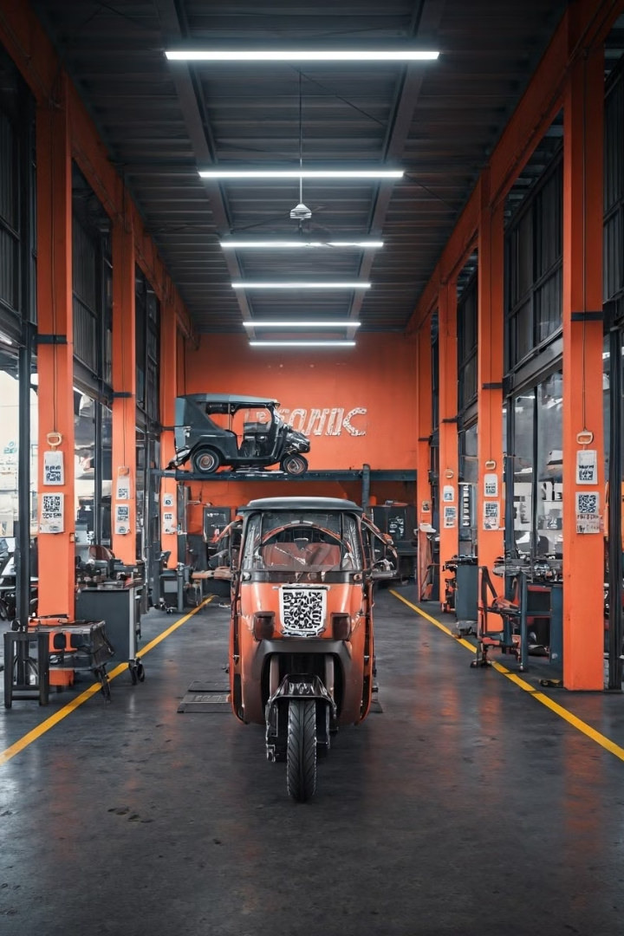
QR-Based Job Record and Management System
Innovative solution for Deshapriya Motors' growing business needs.
Dineth Dilanka (RAT/IT/2324/F/0017)

Slide 2
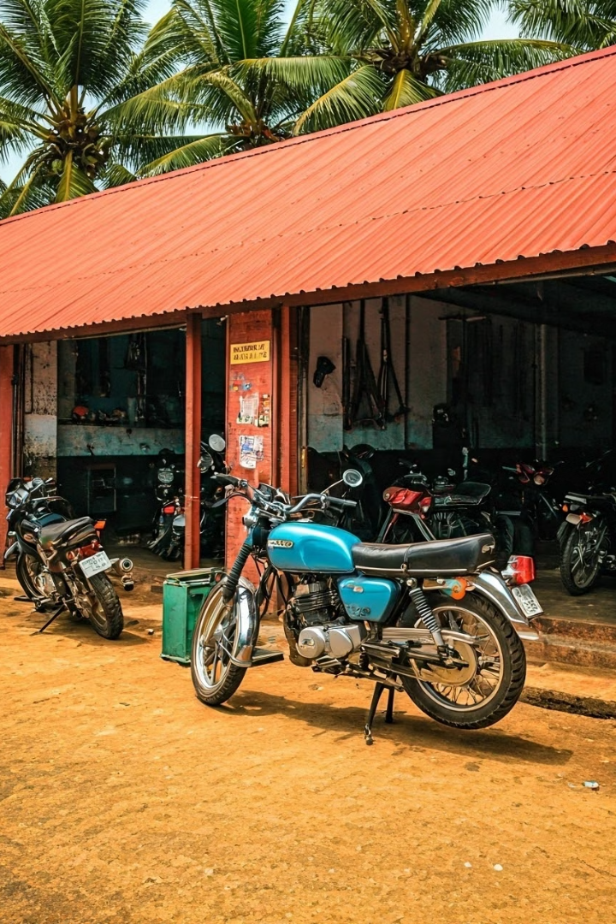
Business Background
1
Established
Authorized dealership of David Pieris Motor Company.
2
Services
Maintenance for motorcycles, three-wheelers, and Bajaj Qute.
3
Growth
Increasing employees and daily jobs.

Slide 3





Expected Outcomes
Operational Efficiency
Enhanced Accuracy
Streamlined job tracking and management.
Precise recording of job details.
Record Keeping
Employee Motivation
Information Based decision making
Transparent incentive calculations.

Slide 4

Progress Made
Data Collection &
QR Integration
Data Integration and
Database Development
Website Mockup
Google Forms and Sheets implemented. QR generation for links established.
Microsoft Access database created.
Demonstration of How the Display Website would look

Slide 5

Questions and Discussion
Thank You!

